Slide 1


TIMELINE COVER PHOTO
TIMELINE COVER PHOTO

Slide 2
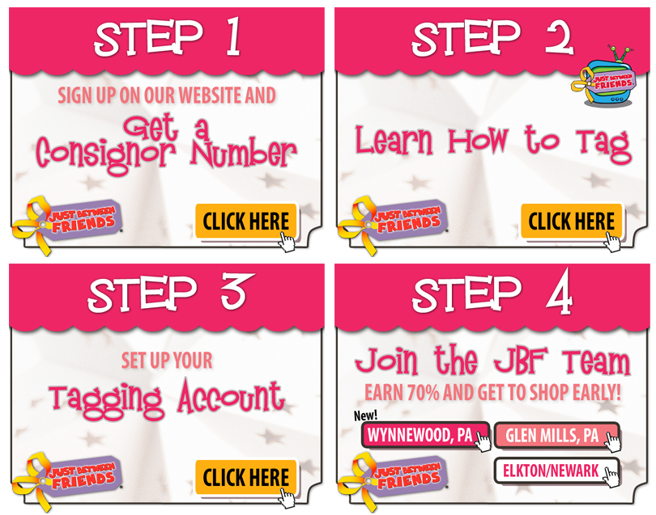



TAB 1:
CONSIGN WITH US

Slide 3





TAB 2:
SHOP WITH US

Slide 4





TAB 3:
FREE ADMISSION/
TICKETS

